Slide 1

Multiple Key Authorization
Presented by:
Radhe Koringa (12002080501052)
Raj Patel (12002080501054)
College : GCET
Subject : Mini-Project(102040601)
Guided by:
Prof. Vinita Shah

Slide 2
What is Multiple Key Authorization (MKA)?
Multiple Key Authorization (MKA) is an authentication method that requires the user to provide two or more verification keys(shares) to gain access to a resource such as an application, online account, or a VPN. MKA is a core component of a strong identity and access management (IAM) policy. Rather than just asking for a username and password, MKA requires one or more additional verification factors, which decreases the likelihood of a successful cyber attack.

Slide 3
Why is MKA Important?
The main benefit of MKA is it will enhance your organization's security by requiring your users to identify themselves by more than a username and password. While important, usernames and passwords are vulnerable to brute force attacks and can be stolen by third parties. Enforcing the use of an MKA factor like a thumbprint or physical hardware key means increased confidence that your organization will stay safe from cyber criminals.

Slide 4
How our project work?
We will ask user for number of share for encryption.
Then we will take plaintext(message) from user .
we will generate 2 to 10 shares length of plaintext based on user requirement minimum For encryption we will use ceaser-cipher and other python modules like pyfiglet , getpass , colored module
For decryption firstly we will ask for number of share for cross check with encryption and we will ask for share .
Based on entered share it will ddecrypt message.

Slide 5
What we will use in our project
Figlet format in python to show figlet text
Random key generator
Matching function to match keys
Getpass function to hide password
Secret Module

Slide 6
Secret Module
The secrets module is used for generating random numbers for managing important data such as passwords, account authentication, security tokens, and related secrets
secrets.choice(sequence): This function returns a randomly-chosen element from a non-empty sequence to manage a basic level of security.

Slide 7
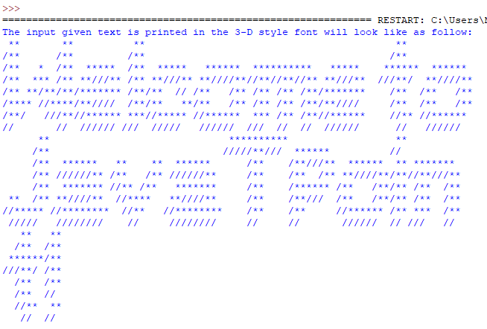
Pyfiglet module
The pyfiglet module is used for generating ASCII art from text. In the provided code, it is used to generate the header text for the program. Example usage: import pyfiglet # Generate ASCII art from text ascii_art = pyfiglet.figlet_format("Hello World!") print(ascii_art)

Slide 8
Termcolor Module
The termcolor module provides support for ANSI escape sequences for colored output on the terminal. In the provided code, it is used to color the header text.
Example :
from termcolor import colored
# Color a string with red foreground and yellow background
colored_text = colored("Hello, world!", "red", "on_yellow")
print(colored_text)

Slide 9
Process of MKA
User initiates a request for access to a system or resource.
System prompts the user to provide one or more authentication factors.
User provides the requested authentication factors.
System verifies the authentication factors provided by the user.
If the authentication is successful, the system grants access to the user.

Slide 10
References
https://www.geeksforgeeks.org/
Tutorials List – Javatpoint
Python Tutorial (tutorialspoint.com)
sys — System-specific parameters and functions — Python 3.11.3 documentation

Slide 11
Thank You

